Slide 1

CS 540 : Machine Learning in Finance
Bitcoin Price Direction for Using Sentiment Signals from News and Social Media
Team member
Ali Baki Türköz

Slide 2

INTRODUCTION
Cryptocurrencies—especially Bitcoin and Ethereum—trade 24/7 and show high volatility as well as volatility clustering. For this reason, forecasting short-term price movements is important for both academic research and practical use.
It is not clear whether these returns are truly predictable, because in an efficient market prices are expected to already reflect public information. However, crypto investors often rely heavily on online channels such as news websites, Twitter, and forums. Therefore, news and social-media sentiment and attention measures may provide extra signals about future price direction.
In this study, the aim is to test how well short-term crypto price direction can be predicted in a realistic out-of-sample setting using a walk-forward evaluation. A price-based baseline model is compared with extended models that add news and social-media sentiment/attention signals, and the added value of these signals is evaluated in a systematic way.

Slide 3
Literature Review and Our Work
Literature Review;
Amjad & Shah used the Bitcoin price time series and framed price direction as a 3-class classification problem (Up / Down / No-change). They evaluated their models with sequential tests that preserve time order and reported about 60% to 70%+ accuracy.
McNally et al. predicted BTC/USD daily price direction by using ARIMA as a baseline and comparing it with RNN and LSTM models. They followed a time-series split for train/validation. Their best result was with LSTM, reaching 52.78% accuracy.
Kim et al. used crypto forum data (topics, comments, replies) instead of Twitter. They extracted daily attention features (e.g., number of topics, replies, views) and sentiment indicators created with VADER (e.g., counts of positive/negative comments and replies). They applied Granger causality to select the most meaningful time lags, then used a Bayesian classifier called AODE (Aggregating One-Dependence Estimators) to make binary predictions of price/transaction volatility. For Bitcoin, using 697 days for training and 94 days for testing, they reported their best result for price volatility prediction as 79.57% accuracy with a 6-day lag.
Our Work;
Our goal is to test how well short-term crypto price direction can be predicted by systematically comparing different information sources.
First, we build a baseline model using only price-based features, such as past prices and returns.
Then, we create extended models by adding sentiment indicators and attention measures from news articles and Twitter posts, which may reflect investor behavior and market perception.
In this way, we aim to directly measure:
the predictive power of price information only, and
the additional contribution of combining price + news sentiment + Twitter sentiment.
.

Slide 4

DATA
News Dataset (Bitcoin News)
Source: Kaggle — oliviervha, “Crypto News”
Time period: 2021-10-12 to 2023-12-19
Content: Crypto news headline + article text, source website, topic tag, etc.
Preprocessing: We filtered only Bitcoin-related news and computed sentiment scores using VADER.
Crypto Fear & Greed Index
📌 What does the data measure?
  It summarizes daily Bitcoin investor sentiment into a single score.
  0 = Extreme Fear, 100 = Extreme Greed
🧩 Data source and data collection method
  Daily index data was collected from Alternative.me’s public API (alternative_fear_greed_api).
  In Python, a GET request was used to retrieve JSON, and the data field was converted into a pandas DataFrame.
  timestamp (Unix) was converted into a calendar date to create the date variable.
📂 Main columns used
  date: day
  Fear_Greed_value: score from 0 to 100
  value_classification: label (Extreme Fear / Fear / Neutral / Greed / Extreme Greed)
⚙️ How is the index computed? (Alternative.me components) (alternative_fear_greed)
  Volatility (25%): higher volatility → fear
  Momentum / Volume (25%): strong buying volume + rising market → greed
  Social Media (15%): higher engagement → more attention / greed
  Surveys (15%): historical investor perception (in some periods)
  Market Dominance (10%): BTC dominance ↑ → fear; ↓ → higher risk appetite
  Search Trends (10%): more searches like “crash/manipulation” → fear
✅ Why is it used?
  It captures market sentiment in a single, daily, interpretable variable, and it complements news sentiment analysis.
Twitter BTC Comment Dataset (Tweet Sentiment)
Source: Kaggle — Ihor Olkhovatyi, “twitter-btc”
Time period: 2021-02-05 to 2023-01-10
Content: Tweets that include “BTC” or “Bitcoin” (tweet text, date, user-related fields, etc.).
Standardization: To keep the sentiment method consistent with the news dataset, we recomputed tweet sentiment using VADER.
BTC Price Dataset (Daily Bitcoin Price)
Source: Kaggle — gamzegedik044, “Bitcoin Daily Price (2015–2025)”
Frequency: Daily price data.

Slide 5
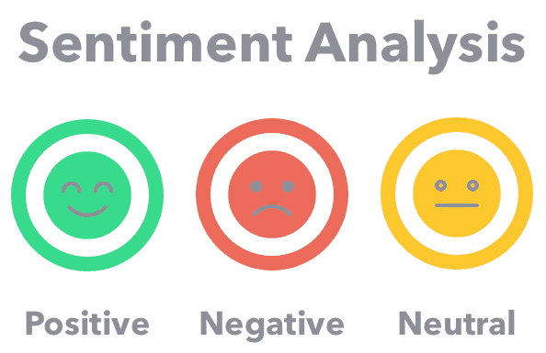
Sentiment Analysis VADER
What is VADER?
VADER is a lexicon- and rule-based sentiment analysis method, designed especially for short texts (e.g., tweets, headlines).
How does it work?
Each word or phrase is matched to a sentiment dictionary and gets a valence score (sentiment strength).
Then the score is adjusted using simple language rules, such as:
  Negation: not, never
  Intensity: very, extremely vs. slightly
  Emphasis: ALL CAPS, !, ?
  Contrast: sentiment after “but” is weighted more
Outputs (VADER scores)
neg (negative): proportion of negative sentiment (fear, bad news, negative tone)
neu (neutral): proportion of neutral content (informative / no emotion)
pos (positive): proportion of positive sentiment (optimism, good news)
neg / neu / pos are each between 0 and 1, and for the same text:
neg + neu + pos = 1
compound: a single overall sentiment score between -1 and +1
  close to +1 → very positive
  close to -1 → very negative
  around 0 → neutral or mixed

Slide 6
Data Processing
News + Twitter + BTC Price (Daily Merge)
Daily aggregation:
News and tweets were grouped by date, and we computed the daily average of VADER sentiment scores.
Data reduction:
We removed the raw text and kept only Date + daily sentiment summaries.
Merging process:
The daily BTC price dataset was merged with the daily news sentiment and daily tweet sentiment datasets using Date as the key.
Filtering:
Days that were not common across all three sources were removed. We kept only the dates where price + news + Twitter data were all available.
Final dataset:
167 days in total, but the timeline is not continuous (there are gaps between dates).
Fear & Greed + News + BTC Price (Daily Merge)
Adding Fear & Greed:
We included the daily Alternative.me Fear & Greed Index.
News processing:
News sentiment was aggregated to daily averages by date.
Merging:
We merged BTC daily price, daily news sentiment, and Fear & Greed using Date as the key.
Dataset design:
In this dataset, Twitter-related columns were removed.
Final dataset:
709 rows with a continuous daily timeline (one row per day).
We used two main datasets:BTC + News + Twitter (167 days) The timeline is not continuous (there are gaps between dates).BTC + News + Fear & Greed (709 days) The timeline is continuous (no gaps).

Slide 7


Methodology
How Are the Thresholds Defined?
Return definition: We use the daily log return
The model target is the direction of next-day return ( r_t+1)
Quantile / tercile labeling: In each walk-forward fold, we compute two thresholds only from the TRAIN part of the ( r_{t+1} ) distribution:
  ( qlow = Q_{0.33} ) (bottom 33%)
  ( qhigh = Q_{0.67} ) (top 33%)
3-class definition:
No look-ahead: Thresholds are derived only from the training data and then applied to the test part of the same fold, preventing future information leakage.
Prediction Task
Goal: Predict the next-day closing direction of Bitcoin.
Problem type: 3-class classification
  Down
  No-change
  Up
Evaluation setup: We used walk-forward validation to keep the time order and avoid look-ahead bias.

Slide 8
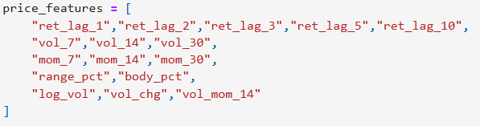
Feature Engineering
Baseline: Price Features (OHLCV)
We use 16 price-based features derived from OHLCV data, as:
Behavioral Signals
Fear & Greed Index (1 feature)
A single daily value from 0 to 100:
  0 = Extreme Fear
  100 = Extreme Greed
News sentiment (4 features: neg / neu / pos / compound)
  neg / neu / pos: each is between 0 and 1 (and sums to 1 for a given text set)
  compound: overall sentiment score
Twitter sentiment (4 features: neg / neu / pos / compound)
  compound: ranges from -1 to +1 (negative to positive overall sentiment)

Slide 9
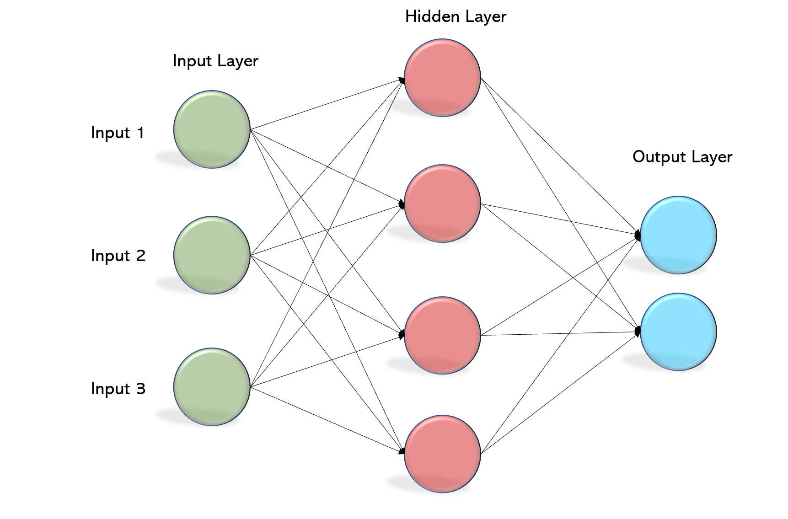
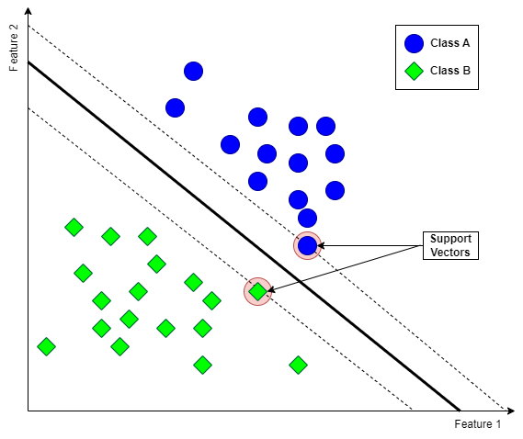
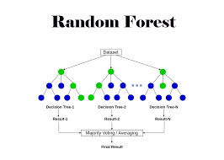
Modeling
MLP_1HL_8: (8) → ,max_iter=5000, random_state=42
MLP_1HL_4: (4)StandardScaler
MLP_2HL_4_4: (4,4)StandardScaler
MLP_2HL_8_4: (8,4)StandardScaler
1 Hidden Layer means 8 neuron.
LogReg (StandardScaler + max_iter=5000, random_state=42)
Linear SVM (StandardScaler + LinearSVC, random_state=42)
RBF SVM (StandardScaler + SVC(kernel=rbf), random_state=42)
Random Forest (random_state=42)
Extra Trees (random_state=42)
Gradient Boosting (random_state=42)
HistGradientBoosting (random_state=42)

Slide 10
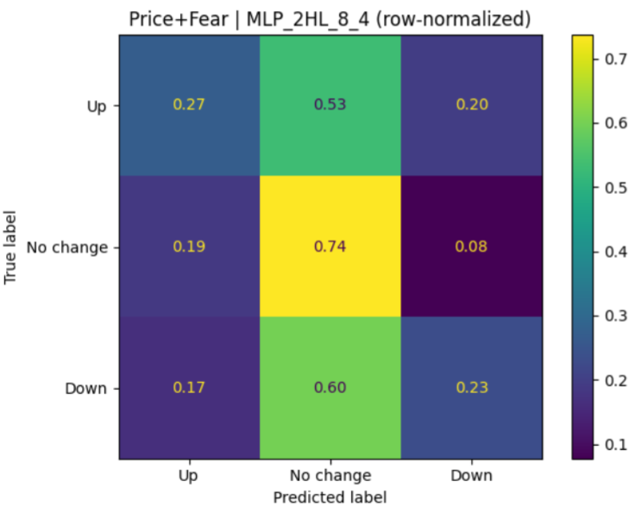
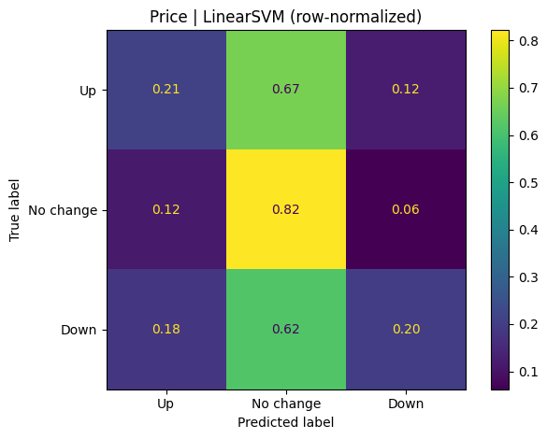
Modelling Results BTC Price, Fear & Greed and News Dataset (709 Days)
Best ML Results
Price: Best model = Linear SVM → Accuracy = 0.500 ± 0.131
Price + Fear: Best model = Linear SVM → Accuracy = 0.500 ± 0.142
Price + News: Best model = Linear SVM → Accuracy = 0.493 ± 0.130
Price + Fear + News: Best model = Linear SVM → Accuracy = 0.474 ± 0.141
Best MLP Results
Price: Best MLP = MLP (1HL, 8) → Accuracy = 0.456 ± 0.111
Price + Fear: Best MLP = MLP (2HL, 8, 4) → Accuracy = 0.485 ± 0.145
Price + News: Best MLP = MLP (2HL, 4, 4) → Accuracy = 0.456 ± 0.094
Price + Fear + News: Best MLP = MLP (2HL, 4, 4) → Accuracy = 0.463 ± 0.145

Slide 11
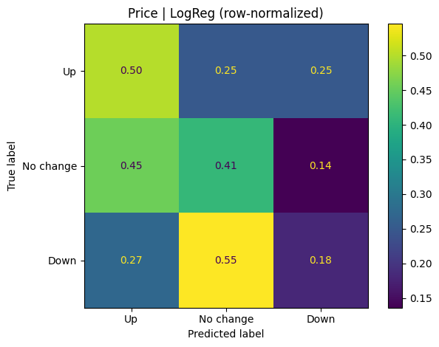
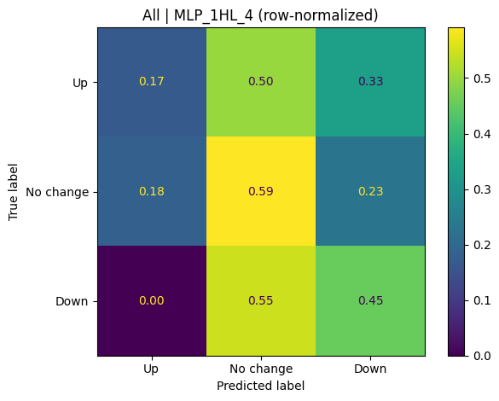
Modelling Results BTC Price, Tweets and News Dataset (167 day
Best ML Results
Price only: Best model = Linear SVM, Accuracy = 0.378 ± 0.077
Price + News: Best model = Linear SVM, Accuracy = 0.378 ± 0.039
Price + Twitter: Best model = Linear SVM, Accuracy = 0.356 ± 0.039
Price + Twitter + News: Best model = Logistic Regression, Accuracy = 0.356 ± 0.039
Best MLP Results
Price only: Best model = MLP (1 hidden layer, 4 units), Accuracy = 0.356 ± 0.102
Price + News: Best model = MLP (2 hidden layers, 8 and 4 units), Accuracy = 0.333 ± 0.067
Price + Twitter: Best model = MLP (2 hidden layers, 8 and 4 units), Accuracy = 0.311 ± 0.204
Price + Twitter + News: Best model = MLP (1 hidden layer, 4 units), Accuracy = 0.444 ± 0.039

Slide 12
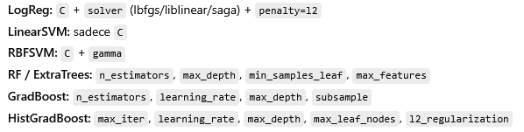
Hyperparameter Tuning
MLP Models – Hyperparameter Tuning
Step 1 (Baseline): For each setup, results were produced using four fixed MLP architectures and ranked by Macro-F1.
Step 2 (Top-5 selection): The top 5 (setup, MLP) combinations were selected from this ranking.
Step 3 (Limited search): Hyperparameter tuning was performed only on these Top-5 models.
Pipeline requirement: All MLPs were trained using a StandardScaler + MLPClassifier pipeline.
Search strategy: Instead of RandomizedSearchCV, we generated parameter combinations in advance, shuffled them randomly, tested them one by one, and selected the best Macro-F1.
Separate search spaces by solver:
  adam: wider grid (e.g., alpha, learning_rate_init, activation, early_stopping, validation_fraction, batch_size, etc.)
  lbfgs: narrower grid (mainly alpha + activation)
Search limit: At most 40 configurations per model were evaluated (to control computation cost).
Speed / stability: We used max_iter = 1000 and suppressed ConvergenceWarning.
ML Models — Hyperparameter Tuning
Scope: Instead of a full search over all model–setup combinations, we first selected the Top-5 (setup, model) pairs based on the baseline results. Hyperparameter tuning was applied only to these Top-5.
Goal: Reduce the search space to lower computational cost and limit the risk of overfitting.
Inner validation (inner CV): For each selected Top-5 model, we used only the first outer training window and applied TimeSeriesSplit (n_splits = 4) to keep the time order.
Search method: We used RandomizedSearchCV with 20 trials per model (n_iter = 20).
Scoring: The optimization metric was Macro-F1.
Class imbalance: In each trial, we used balanced sample weights (via compute_sample_weight) to reduce the impact of class imbalance during training.
Final evaluation: Using the best hyperparameters from inner CV, each model was retrained and evaluated again using the same walk-forward (outer folds) procedure as in the baseline.
The hyperparameter search spaces were defined per model as follows:

Slide 13
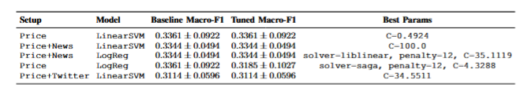
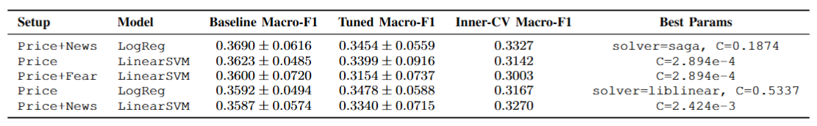
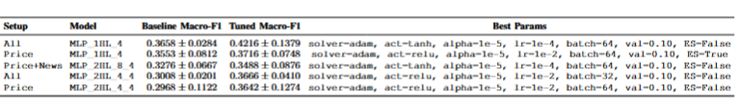
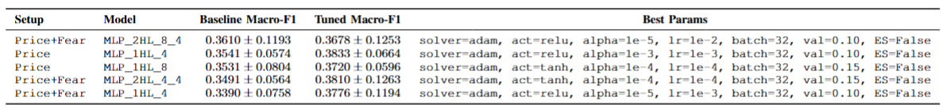
Baseline Vs After Hyperparameters Results
BTC Price, Tweets and News Dataset
ML Modelleri;
MLP Modelleri;
BTC Price, Fear & Greed and News Dataset
ML Modelleri;
MLP Modelleri;
aaaa

Slide 14

CONCLUSİON
We compared ML and MLP models on two BTC datasets using walk-forward evaluation and fold-specific tercile labeling to avoid look-ahead bias.
On the 709-day dataset, traditional ML (Linear SVM) provided the most stable performance; adding sentiment features did not consistently improve accuracy.
On the 167-day dataset, a shallow MLP performed best when combining Price + Twitter + News, but results were less stable due to the small sample.
Hyperparameter tuning was generally not helpful for ML, while it showed potential gains for MLP in selected setups.
Overall, sentiment signals can help in some cases, but their benefit is data- and regime-dependent, so time-series validation is essential.

Slide 15

Future Work
Use richer text methods (e.g., transformer embeddings) instead of only VADER sentiment
Test time-aware models (TCN / LSTM / Transformers) and lagged sentiment features for delayed effects.
Add regime-aware learning (retraining schedules, volatility regimes) to handle market shifts.
Evaluate economic value with trading simulation, including transaction costs and risk metrics.
Extend features with on-chain and derivatives indicators and run stronger robustness checks.

Slide 16

THANK YOU FOR LİSTENİNG

